Slide 1
CAPSTONE PROJECT
SALES ANALYSIS
DATA ANALYTICS
MUSHAB ALI

Slide 2
TABLE OF CONTENTS
INTRODUCTION
OBJECTIVE
SIGNIFICANCE
METHODOLOGY
ER DIAGRAM
EDA PROBLEM STATMENTS
POWER BI PROBLEM STATMENTS
POWER BI DASHBOARD
CONCLUSION

Slide 3

INTRODUCTION
"Unlocking Northwind Traders' Data Secrets"
Welcome to our data exploration journey! Using Power BI and Excel EDA, we'll dive into Northwind Traders' data universe, revealing hidden insights for success.
Join us as we:
Segment Customers: Uncover buying motivations and target high-value prospects.
Analyze Sales: Identify profit hotspots and areas for optimization.
Track Inventory: Ensure efficient stock management and minimize waste.
Evaluate Employees: Recognize top performers and boost team productivity.
With each visualization, we unravel Northwind Traders' mysteries, paving the path for:
Revenue Growth: Targeted strategies for increased profits.
Customer Loyalty: Personalized experiences for lasting connections.
Operational Efficiency: Streamlined processes for cost savings.
Employee Engagement: Empowerment and recognition for a motivated workforce.
Grab your tools, and let's embark on this data-driven adventure together!

Slide 4
OBJECTIVE
Aim: Utilize Power BI and Excel EDA to analyze North Wind Traders' sales data, providing insights into customer behavior, sales patterns, and employee performance to support effective decision-making.
Objectives:
Consolidate data from multiple tables for a comprehensive view of operations.
Analyze sales trends and metrics to understand performance.
Understand customer behavior through segmentation and analysis.
Optimize inventory management processes.
Evaluate employee performance and identify opportunities for improvement.
Deliver actionable insights through intuitive dashboards.
Promote a data-driven culture within the organization.
Enhance business competitiveness by leveraging data insights.
Facilitate continuous improvement through monitoring and feedback.
Outcome: Revolutionize data interaction, drive business growth, and maintain competitive advantage.

Slide 5
SIGNIFICANCE
The North Wind Traders Capstone Project is significant for:
Data-Driven Decision Making: Empowering informed decisions through Power BI and Excel EDA.
Operational Efficiency: Streamlining processes and resource allocation.
Customer Satisfaction: Tailoring products/services to meet customer needs.
Competitive Advantage: Staying ahead in the market with data insights.
Strategic Planning: Fueling innovation and proactive decision-making.
Stakeholder Empowerment: Involving all levels in data exploration and decision-making.
Long-Term Sustainability: Cultivating a culture of continuous improvement and adaptation.

Slide 6
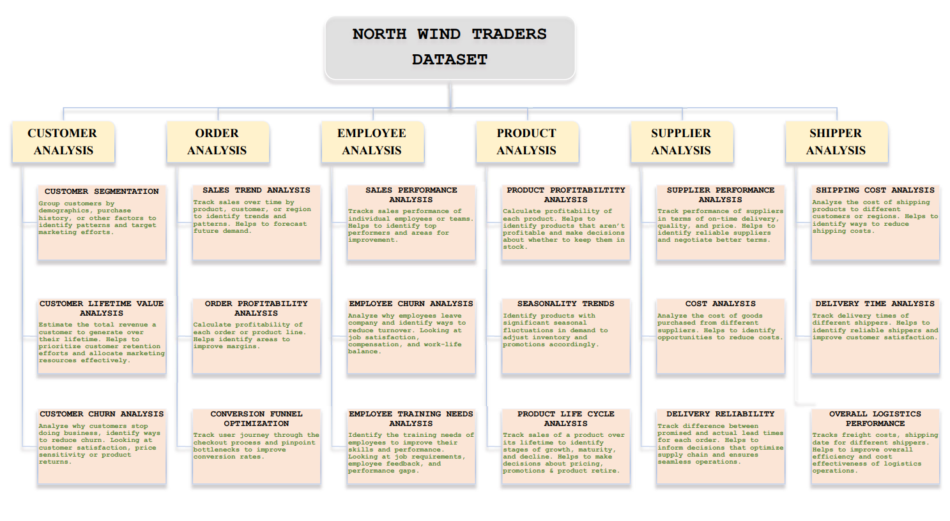
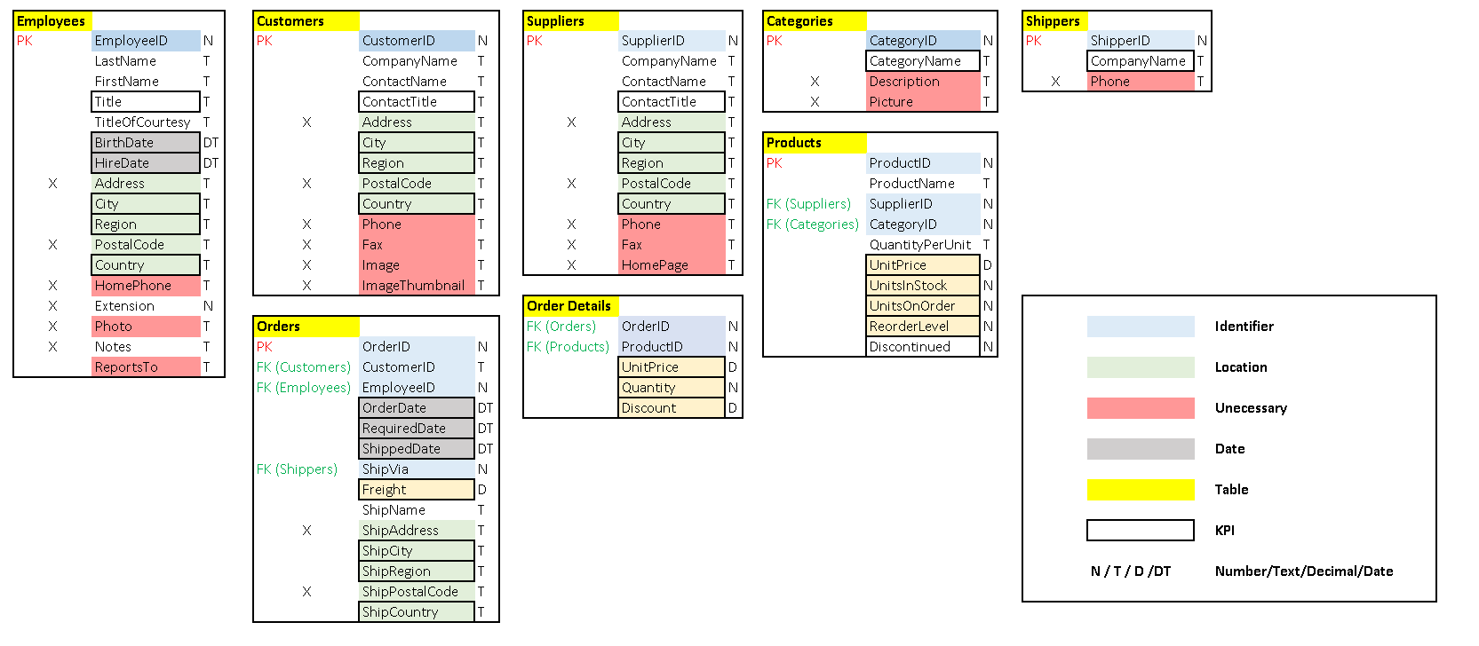
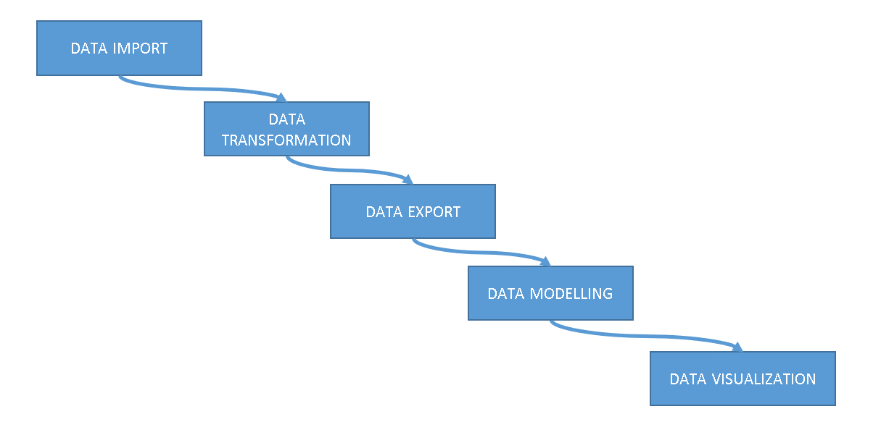
METHODOLOGY
Data Acquisition and Preparation:
Import dataset using provided SQL script into MySQL.
Clean and transform data using SQL queries to address missing values and inconsistencies.
Export prepared data to designated "SQL" folder in suitable format (e.g., CSV).
Data Modeling and Visualization:
Power BI:
Import exported data into Power BI Desktop.
Establish relationships between tables and create calculated columns or measures.
Create visually appealing dashboards with interactive visualizations.
Excel:
Import data into Excel and establish connections between tables.
Utilize Excel's charting options for creating informative visualizations.
Data Interpretation and Insights:
Analyze visualizations to identify key trends and patterns.
Interpret findings considering business context and domain knowledge.
Translate interpretations into actionable insights for stakeholders.
Additional Considerations:
Document methodology, assumptions, and decisions for clarity.
Validate findings and maintain data quality.
Present results effectively, considering visual storytelling techniques.
Continuously refine methodology and visualizations based on feedback and requirements.

Slide 7
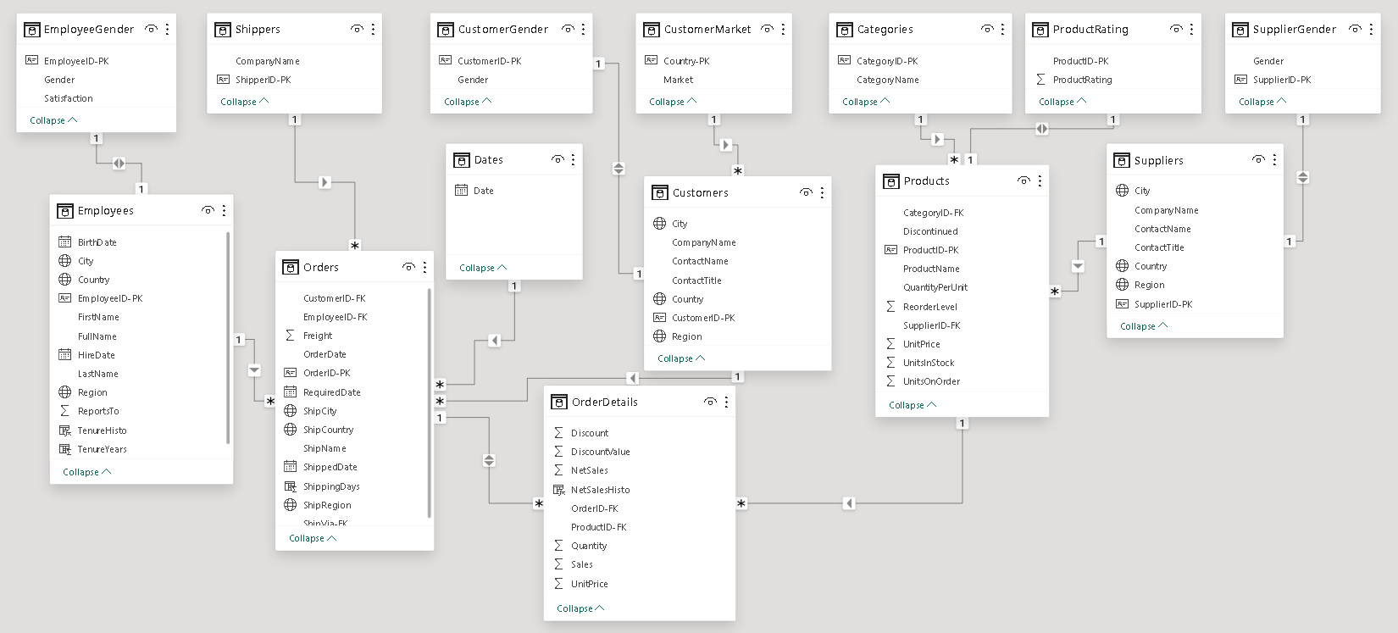
ER DIAGRAM
Entities: Customers, Employees, Suppliers, Products, Orders, Categories
Relationships:
Customers can place orders.
Orders can contain one or more products.
Products belong to one category.
Categories can have many products.
Suppliers can supply many products.
Products can be supplied by many suppliers.
Employees work in one department.
Departments can have many employees.
Attributes:
Customers: customer ID, first name, last name, address, city, state, zip code, country, phone number, email address
Employees: employee ID, first name, last name, address, city, state, zip code, country, phone number, email address, hire date, job title, department
Suppliers: supplier ID, company name, contact name, address, city, state, zip code, country, phone number, email address
Products: product ID, product name, description, price, quantity in stock, category ID
Orders: order ID, customer ID, order date, shipping address, shipping city, shipping state, shipping zip code, shipping country, shipping cost, total amount
Categories: category ID, category name
ER diagrams provide a visual representation of database entities and their relationships, aiding in database design, querying, and manipulation.

Slide 8
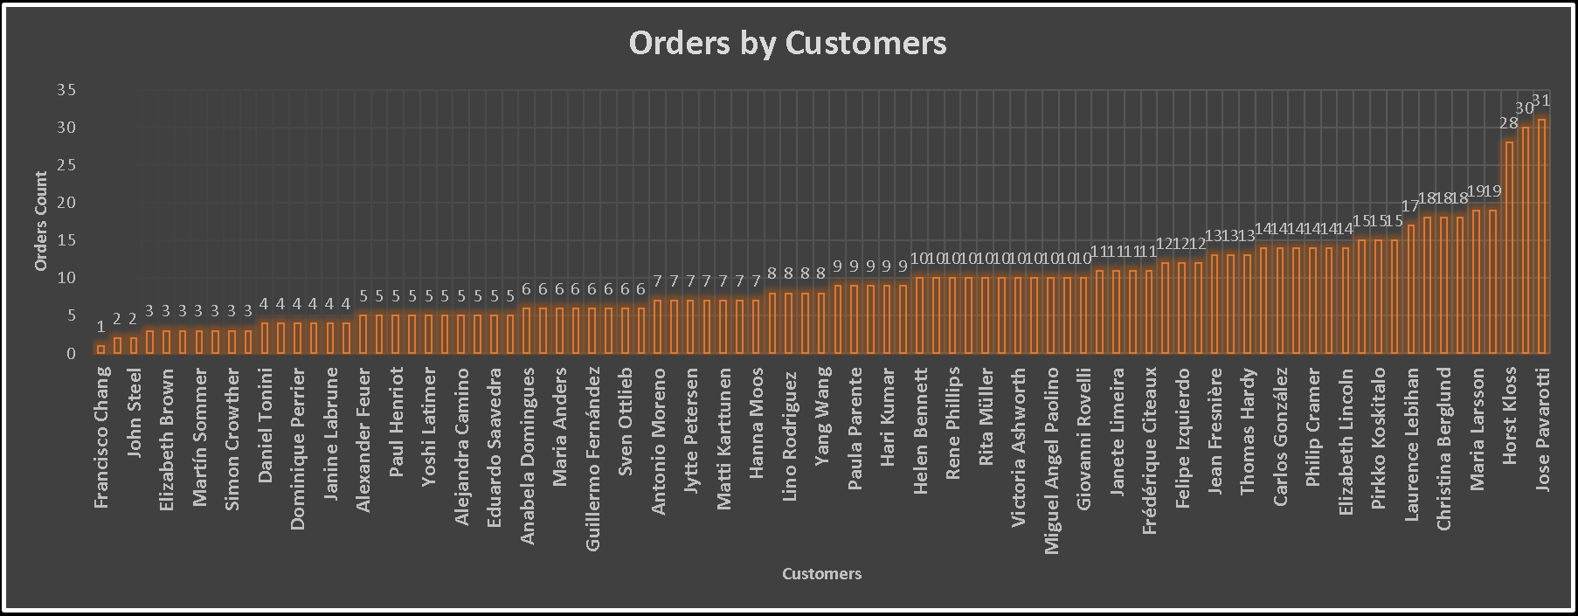
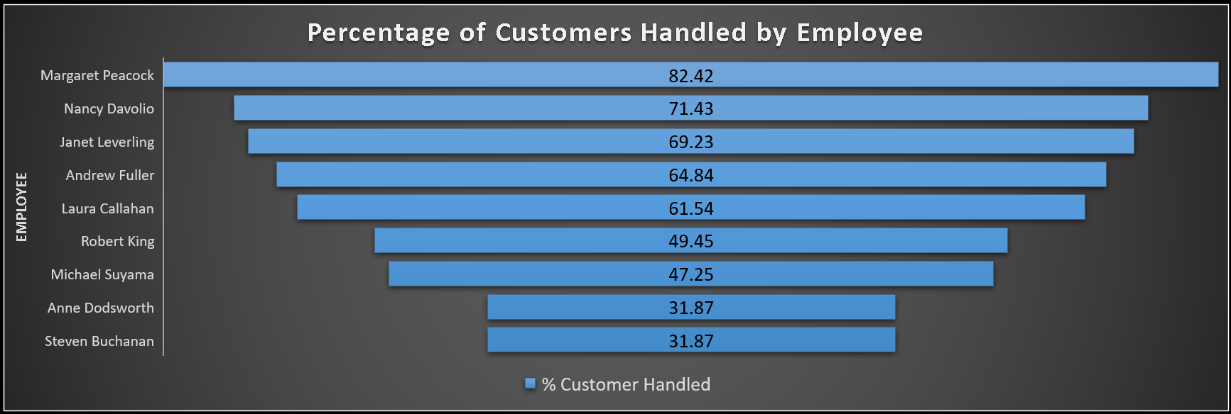
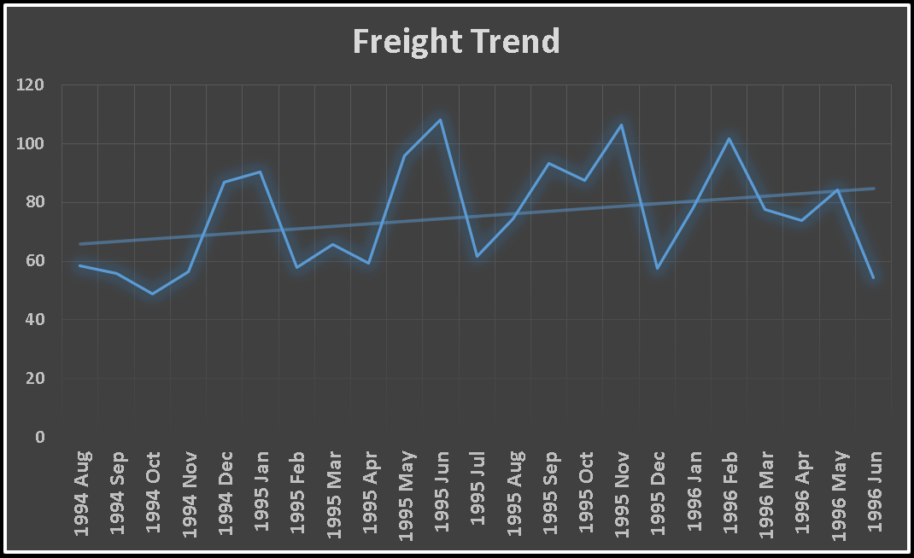
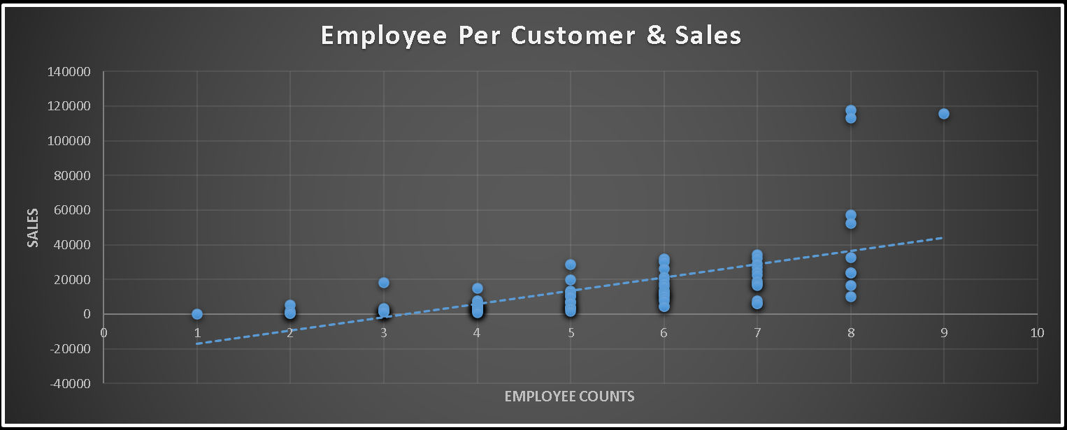
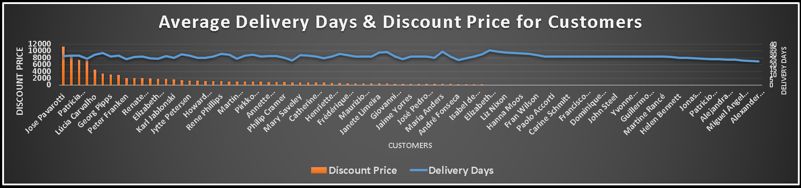
EDA PROBLEM STATEMENT
1. WHAT ARE THE KEY FACTORS INFLUENCING CUSTOMER RETENTION OR LOYALTY BASED ON THE DATASET ?

Slide 9
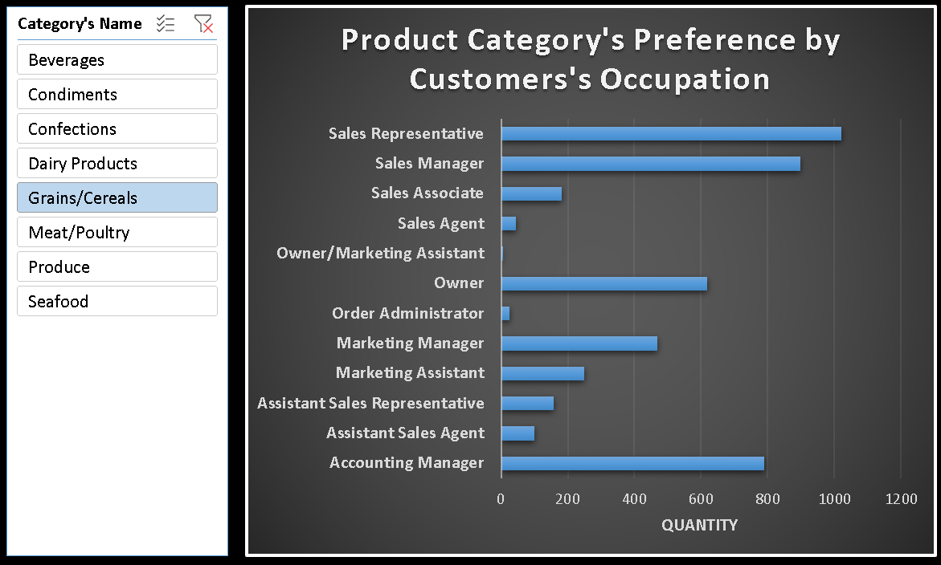
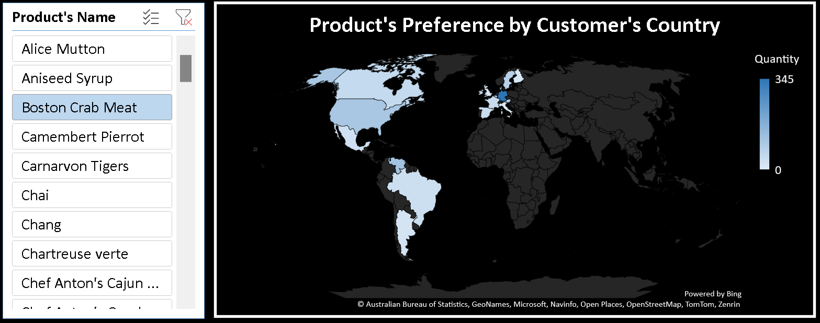
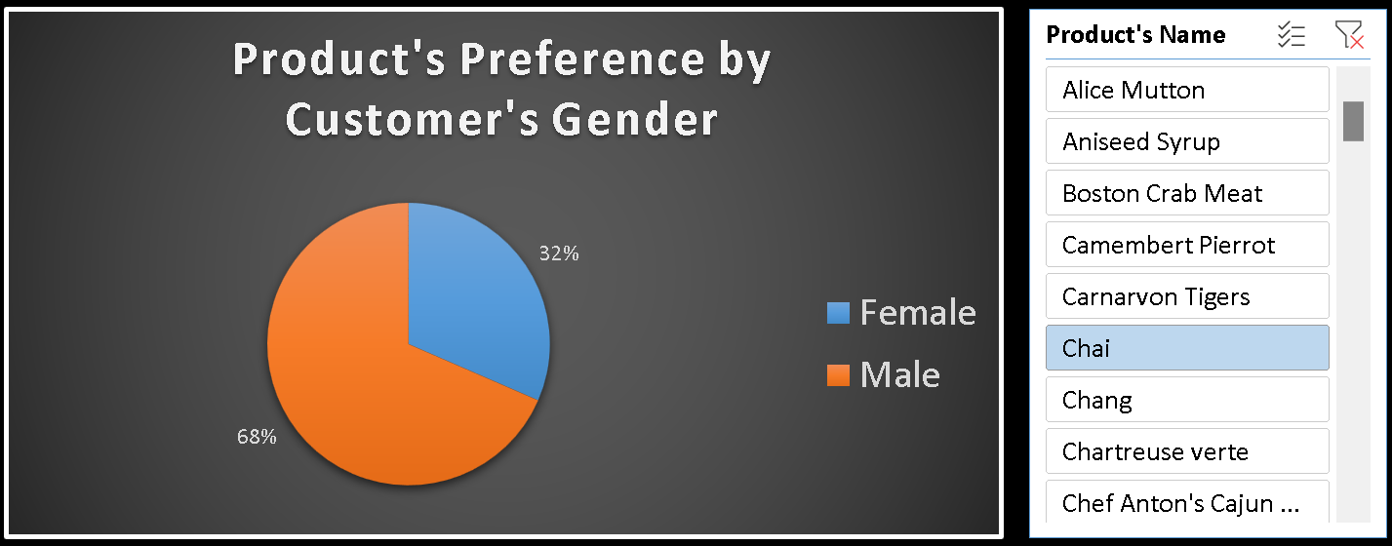
EDA PROBLEM STATEMENT
2. HOW DO CUSTOMER PREFERENCES VARY BASED ON THEIR LOCATION OR DEMOGRAPHICS? CAN WE EXPLORE THIS THROUGH INTERACTIVE VISUALIZATIONS?

Slide 10
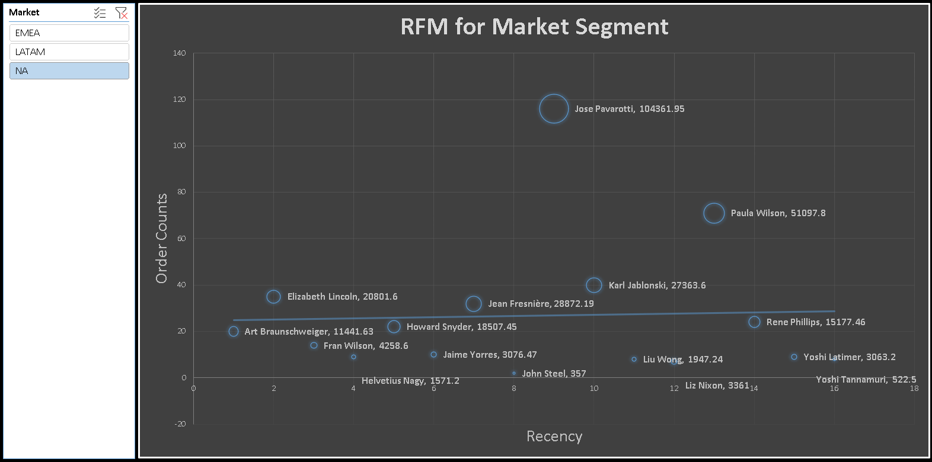
EDA PROBLEM STATEMENT
3. ARE THERE ANY INTERESTING PATTERNS OR CLUSTERS IN CUSTOMER BEHAVIOR THAT CAN BE VISUALIZED TO IDENTIFY POTENTIAL MARKET SEGMENTS?

Slide 11
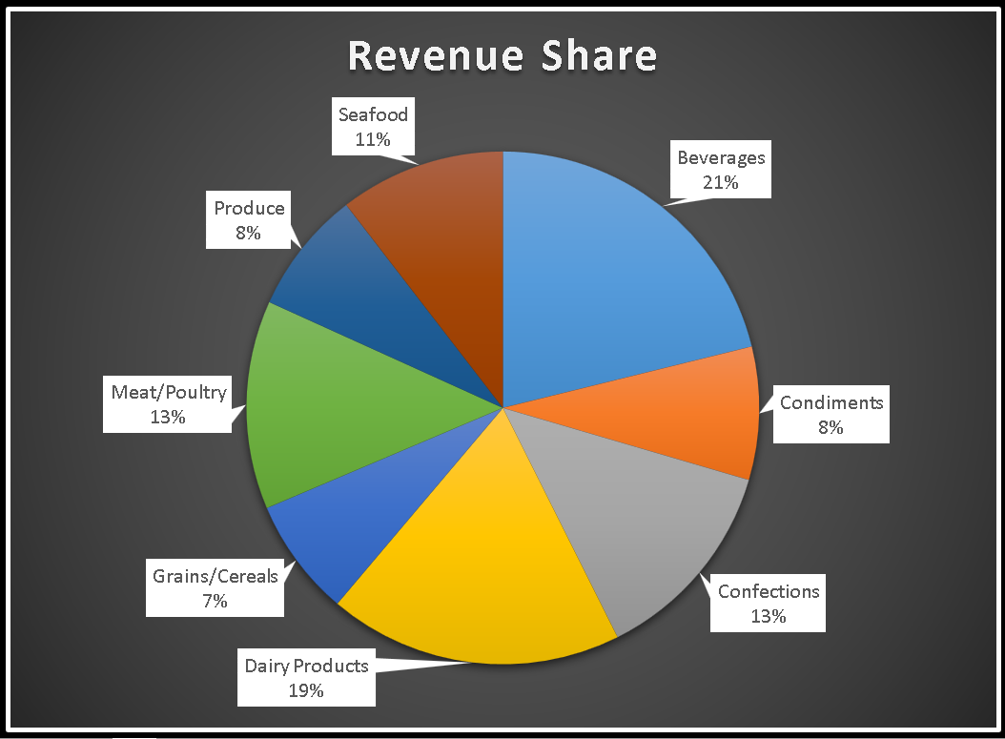
EDA PROBLEM STATEMENT
4. ARE THERE ANY SPECIFIC PRODUCT CATEGORIES OR SKUS THAT CONTRIBUTE SIGNIFICANTLY TO ORDER REVENUE? CAN WE IDENTIFY THEM THROUGH VISUALIZATIONS?

Slide 12
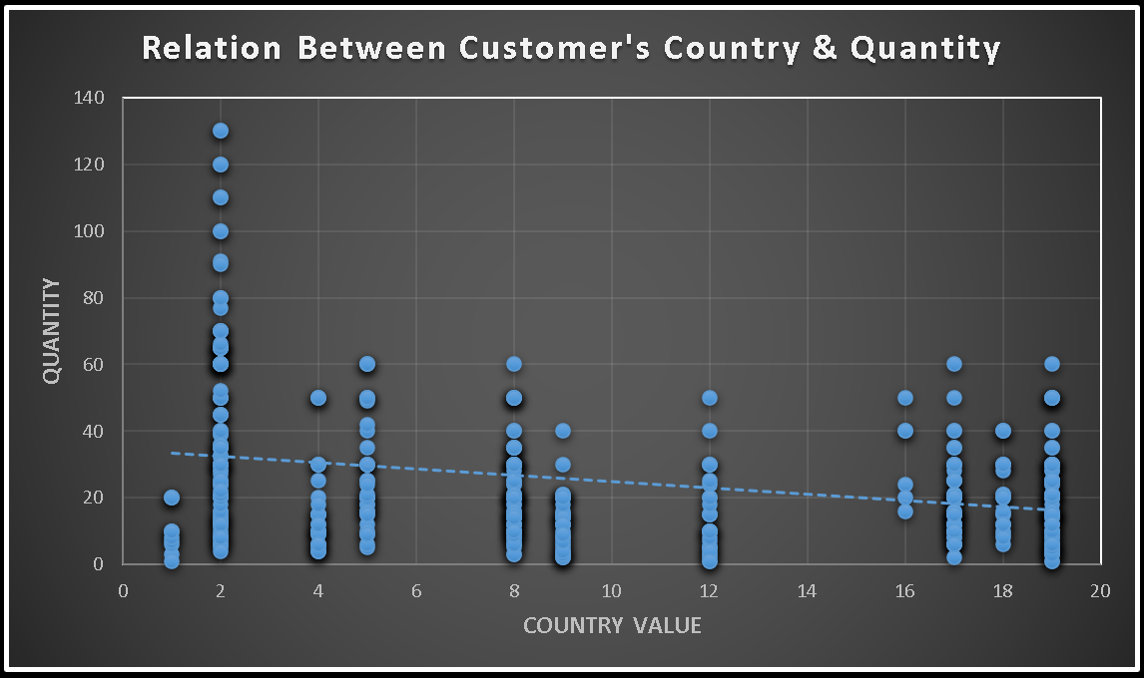
EDA PROBLEM STATEMENT
5. ARE THERE ANY CORRELATIONS BETWEEN ORDER SIZE AND CUSTOMER DEMOGRAPHICS OR PRODUCT CATEGORIES? CAN WE EXPLORE THIS VISUALLY USING SCATTER PLOTS OR HEATMAPS?

Slide 13
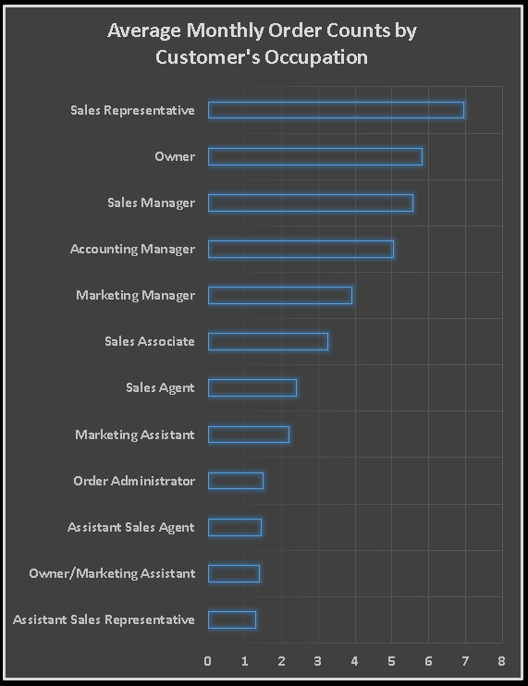
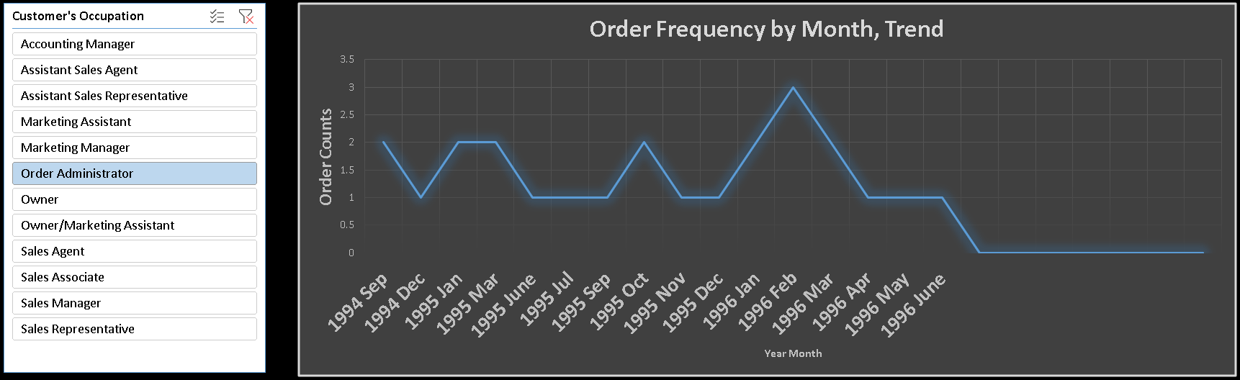
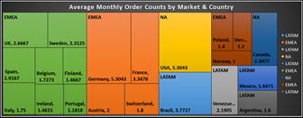
EDA PROBLEM STATEMENT
6. HOW DOES ORDER FREQUENCY VARY ACROSS DIFFERENT CUSTOMER SEGMENTS? CAN WE VISUALIZE THIS USING BAR CHARTS OR TREEMAPS?

Slide 14
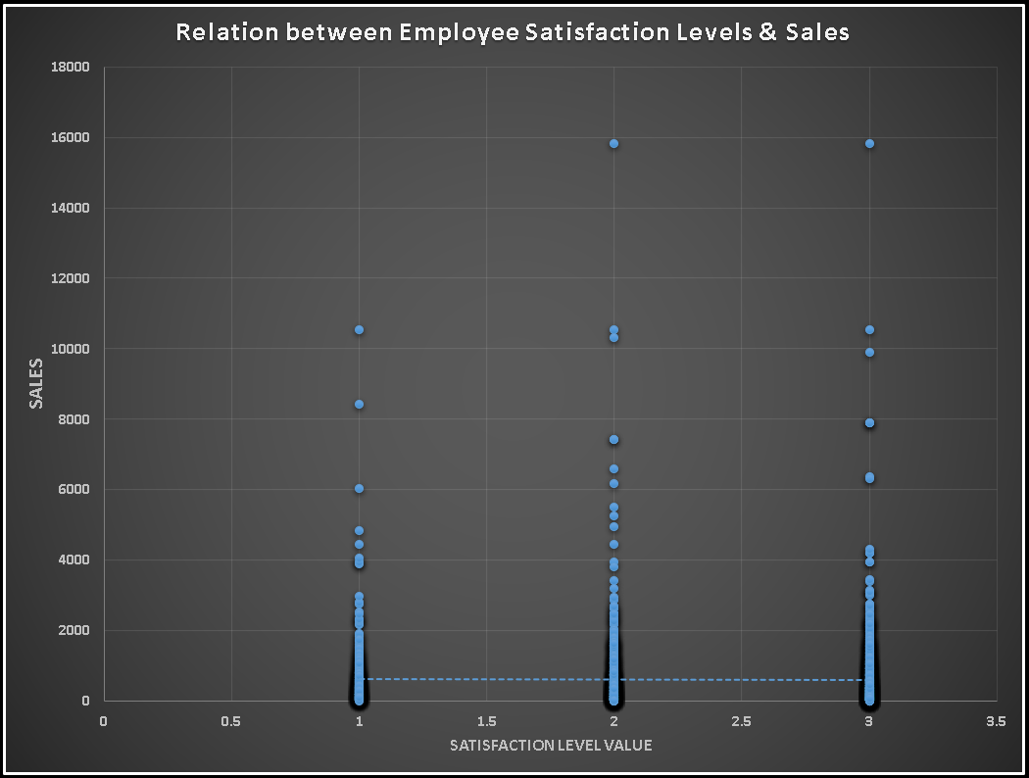
EDA PROBLEM STATEMENT
7. ARE THERE ANY CORRELATIONS BETWEEN EMPLOYEE SATISFACTION LEVELS AND KEY PERFORMANCE INDICATORS? CAN WE EXPLORE THIS VISUALLY THROUGH SCATTER PLOTS OR LINE CHARTS?

Slide 15
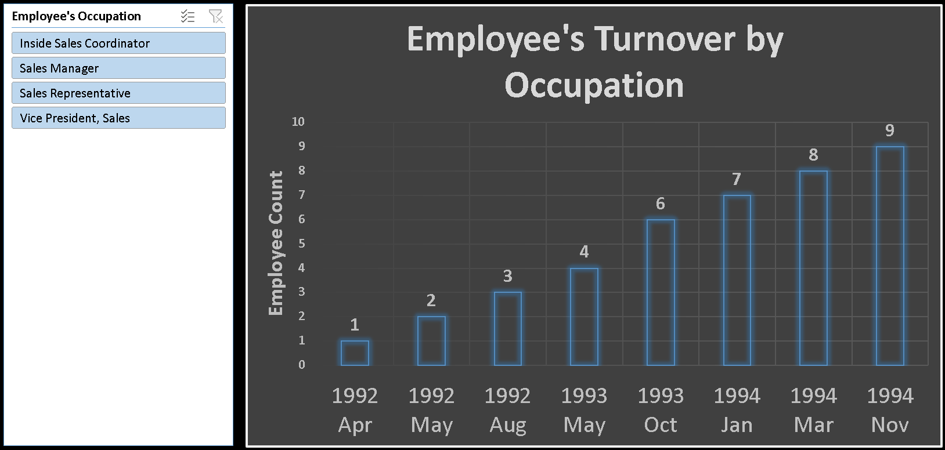
EDA PROBLEM STATEMENT
8. HOW DOES EMPLOYEE TURNOVER VARY ACROSS DIFFERENT DEPARTMENTS OR JOB ROLES? CAN WE VISUALIZE THIS USING BAR CHARTS OR HEATMAPS?

Slide 16
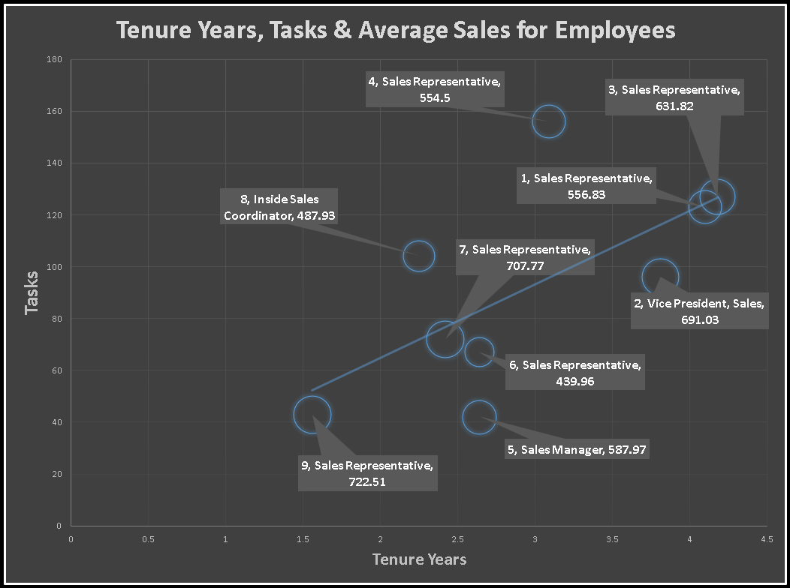
EDA PROBLEM STATEMENT
9. CAN WE IDENTIFY ANY PATTERNS OR CLUSTERS IN EMPLOYEE SKILL SETS OR QUALIFICATIONS THROUGH VISUALIZATIONS? HOW CAN THIS INFORMATION BE USED FOR TALENT MANAGEMENT?

Slide 17
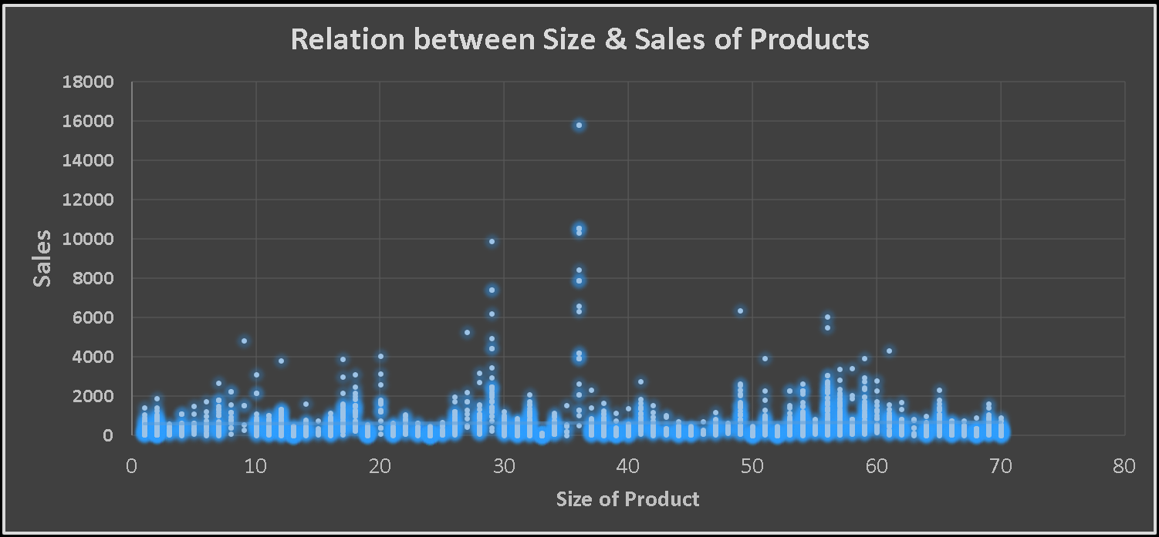
EDA PROBLEM STATEMENT
10. ARE THERE ANY CORRELATIONS BETWEEN PRODUCT ATTRIBUTES (E.G., SIZE, COLOR, FEATURES) AND SALES PERFORMANCE? CAN WE EXPLORE THIS VISUALLY USING SCATTER PLOTS OR HEATMAPS?

Slide 18
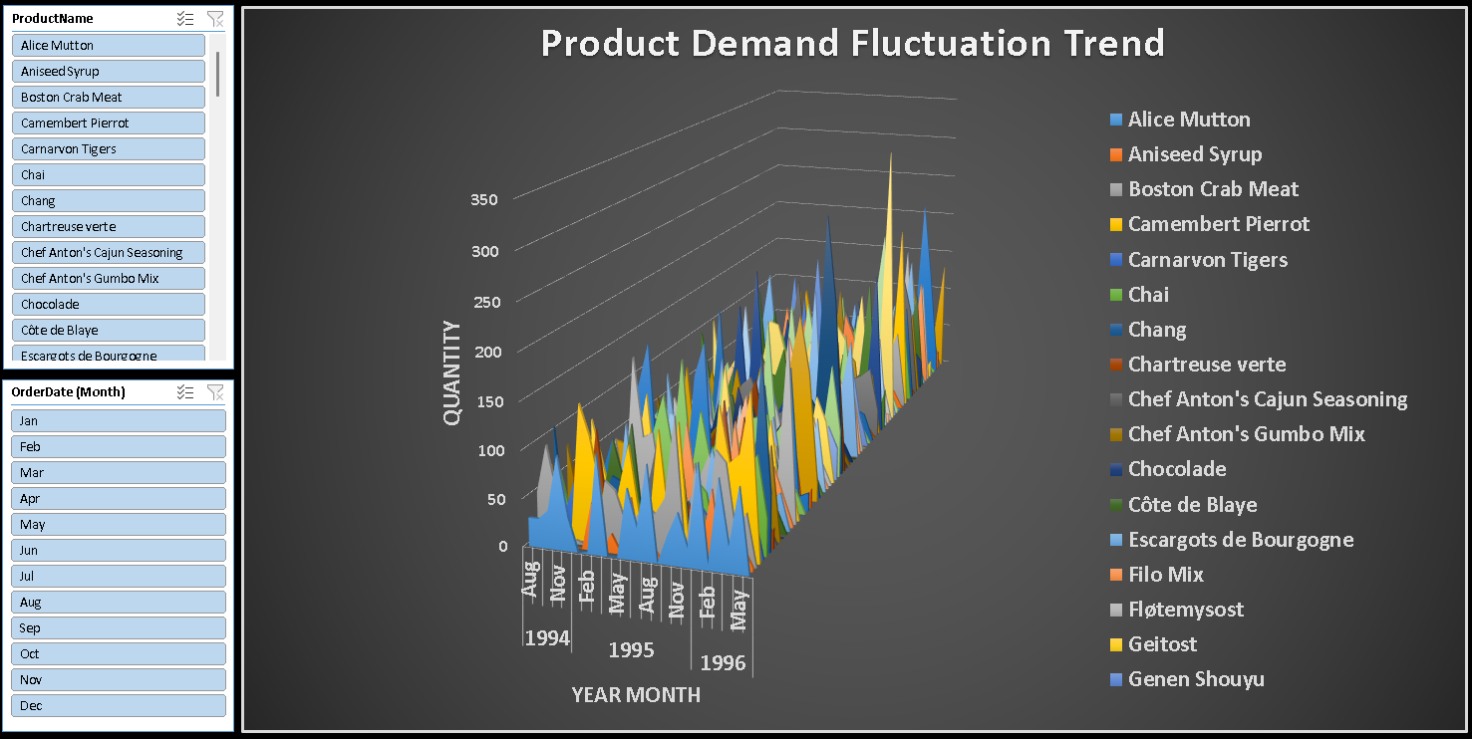
EDA PROBLEM STATEMENT
11. HOW DOES PRODUCT DEMAND FLUCTUATE OVER DIFFERENT SEASONS OR MONTHS? CAN WE VISUALIZE THIS THROUGH LINE CHARTS OR AREA CHARTS?

Slide 19
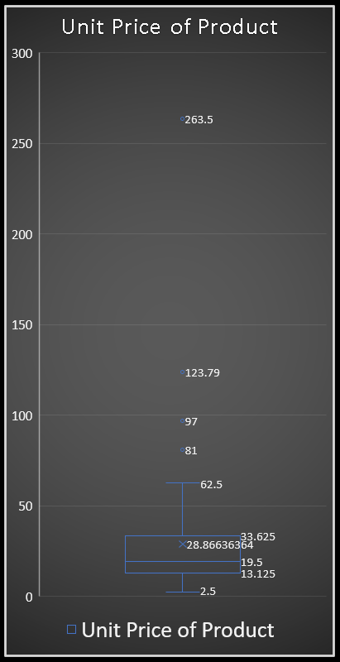
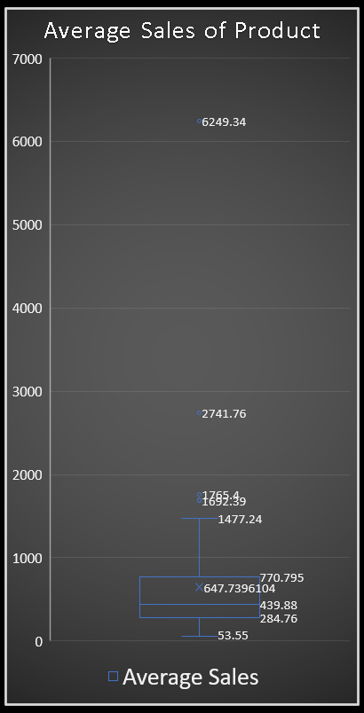
EDA PROBLEM STATEMENT
12. CAN WE IDENTIFY ANY OUTLIERS OR ANOMALIES IN PRODUCT PERFORMANCE OR SALES USING VISUALIZATIONS? HOW CAN THIS INFORMATION BE USED FOR PRODUCT OPTIMIZATION?

Slide 20
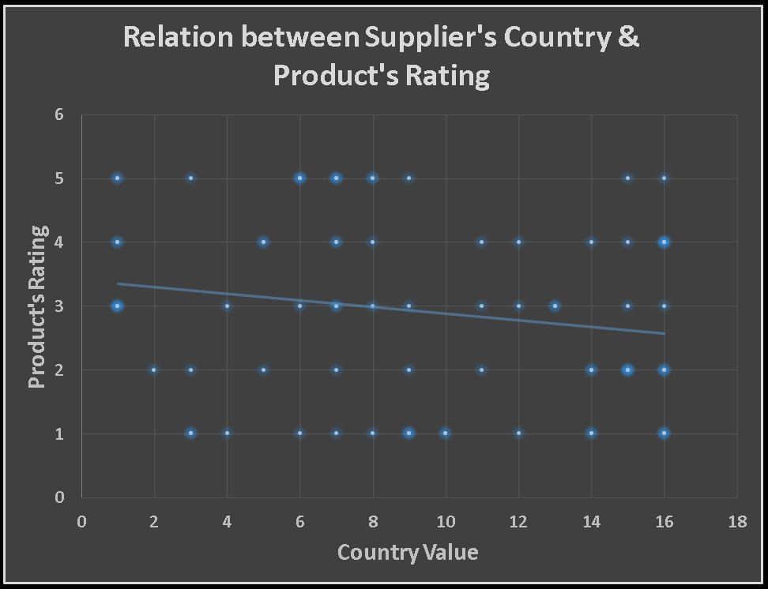
EDA PROBLEM STATEMENT
13. ARE THERE ANY CORRELATIONS BETWEEN SUPPLIER ATTRIBUTES (E.G., LOCATION, SIZE, INDUSTRY) AND PERFORMANCE METRICS (E.G., ON-TIME DELIVERY, PRODUCT QUALITY)? CAN WE EXPLORE THIS VISUALLY THROUGH SCATTER PLOTS OR HEATMAPS?

Slide 21
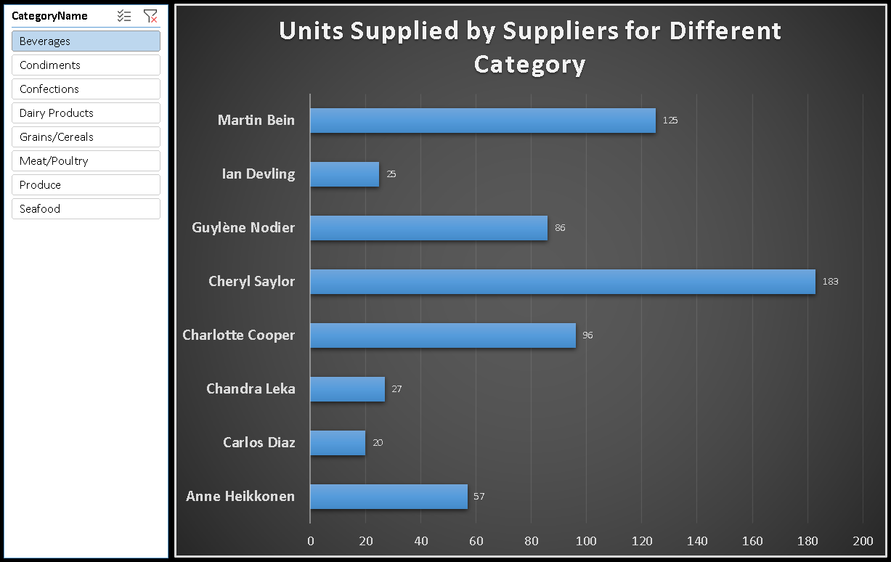
EDA PROBLEM STATEMENT
14. HOW DOES SUPPLIER PERFORMANCE VARY ACROSS DIFFERENT PRODUCT CATEGORIES OR DEPARTMENTS? CAN WE VISUALIZE THIS USING STACKED BAR CHARTS OR GROUPED COLUMN CHARTS?

Slide 22
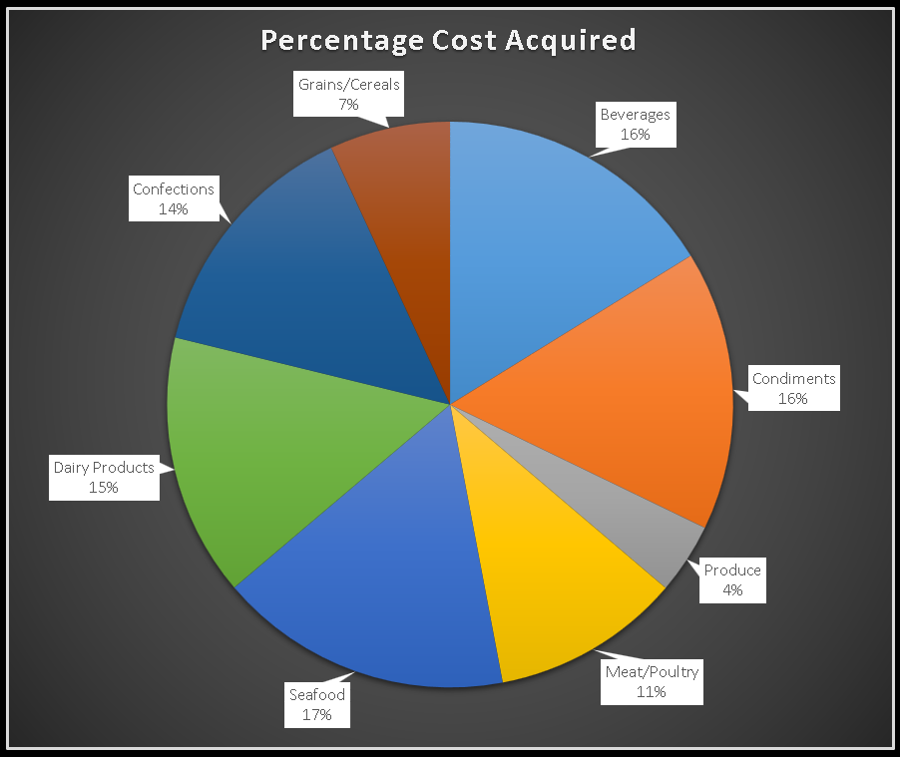
EDA PROBLEM STATEMENT
15. CAN WE IDENTIFY ANY TRENDS OR PATTERNS IN SUPPLIER COSTS OR PRICING STRUCTURES THROUGH VISUALIZATIONS? HOW CAN THIS INFORMATION BE USED FOR PROCUREMENT OPTIMIZATION?

Slide 23
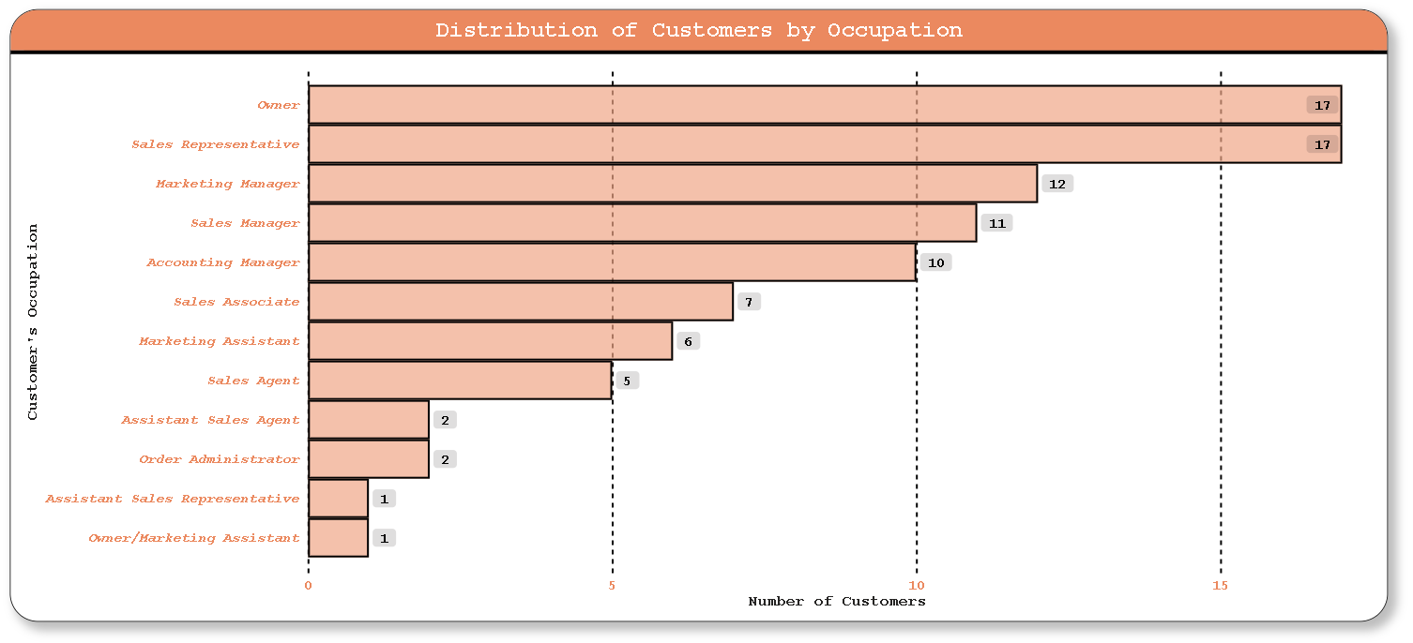
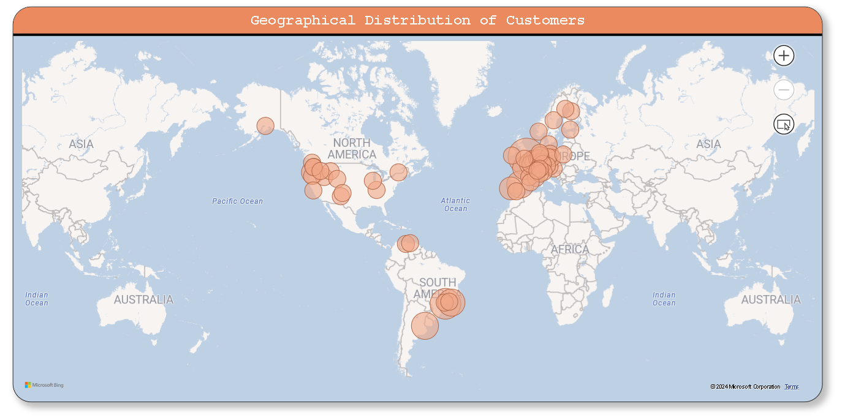
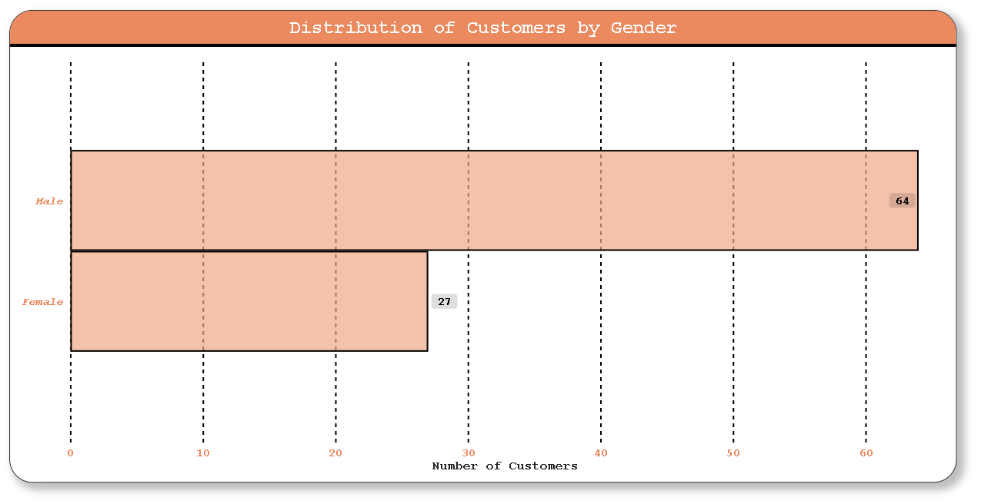
POWER BI PROBLEM STATEMENT
1. HOW DOES CUSTOMER DISTRIBUTION VARY ACROSS DIFFERENT REGIONS OR CUSTOMER SEGMENTS? CAN WE VISUALIZE IT ON A MAP OR BAR CHART?

Slide 24
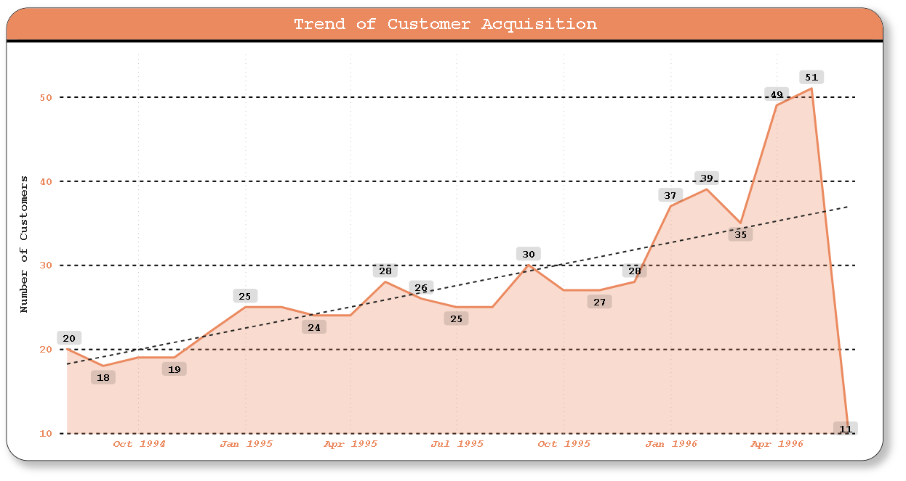
POWER BI PROBLEM STATEMENT
2. WHAT IS THE TREND IN CUSTOMER ACQUISITION OVER TIME? CAN WE CREATE A LINE OR AREA CHART TO DISPLAY IT?

Slide 25
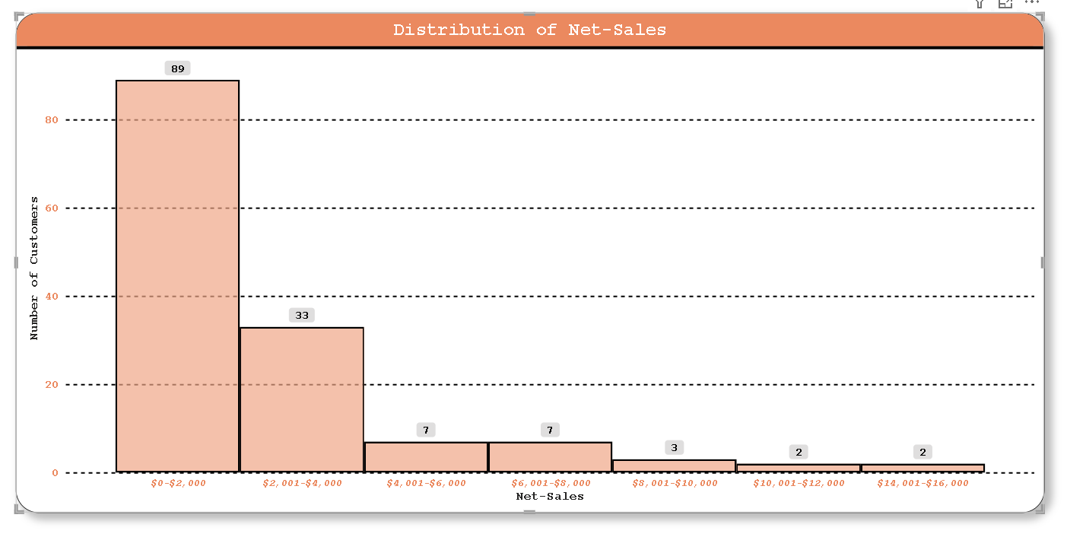
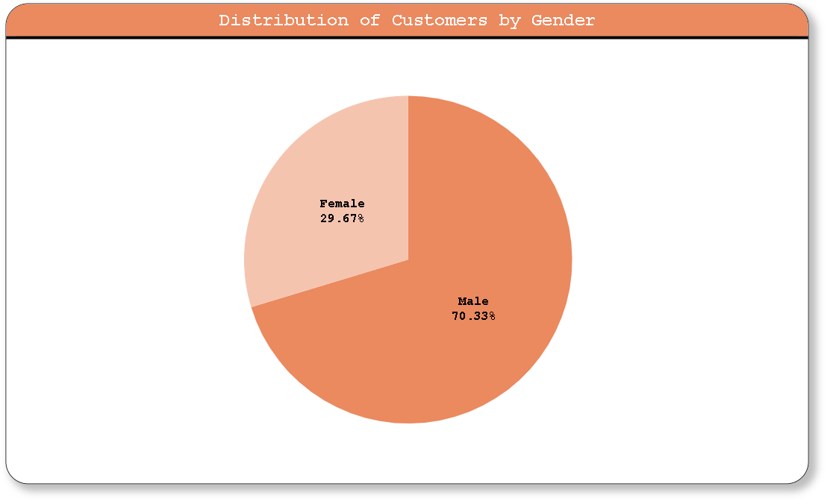
POWER BI PROBLEM STATEMENT
3. CAN WE VISUALIZE THE DISTRIBUTION OF CUSTOMER DEMOGRAPHICS SUCH AS AGE, GENDER, OR INCOME USING HISTOGRAMS OR PIE CHARTS?

Slide 26
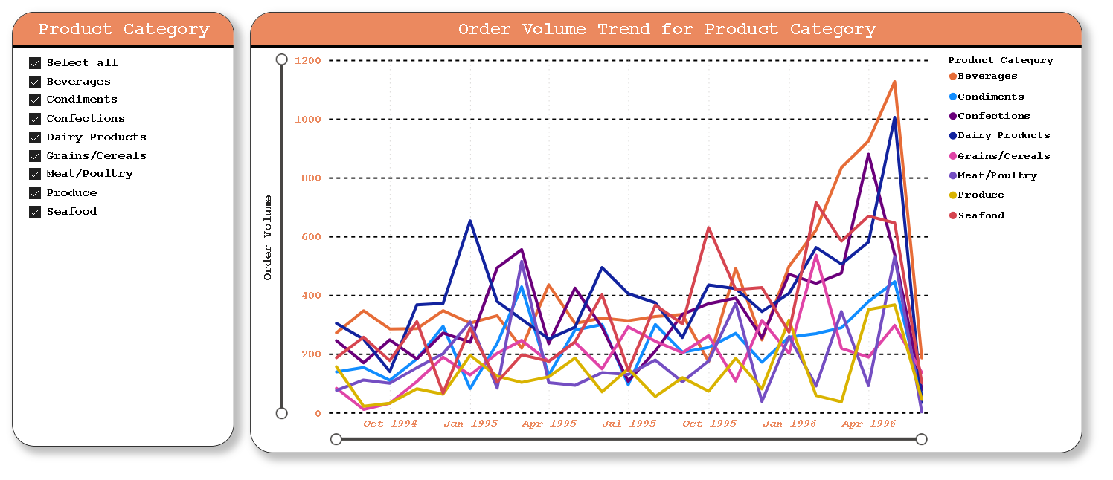
POWER BI PROBLEM STATEMENT
4. HOW DOES ORDER VOLUME CHANGE OVER TIME? CAN WE CREATE A TIME SERIES CHART OR STACKED BAR CHART TO VISUALIZE IT?

Slide 27
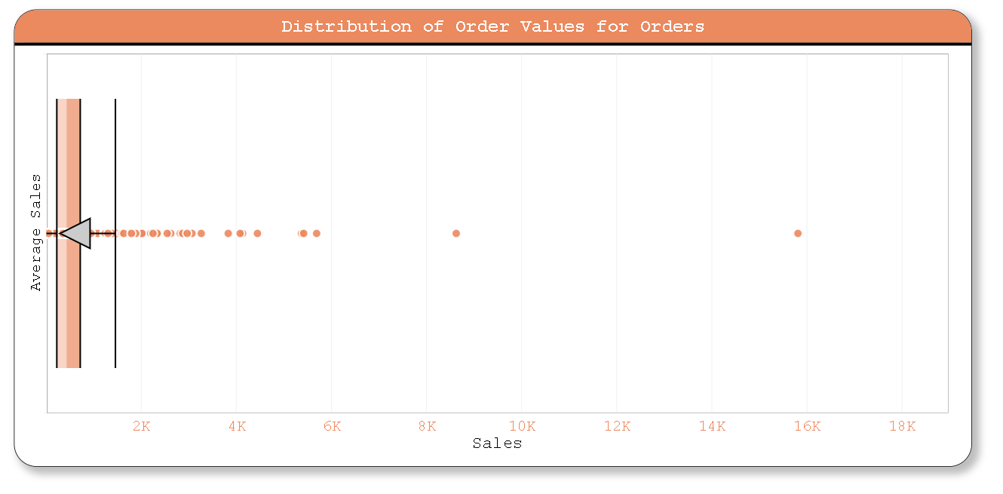
POWER BI PROBLEM STATEMENT
5. WHAT IS THE DISTRIBUTION OF ORDER VALUES? CAN WE CREATE A HISTOGRAM OR BOX PLOT TO DISPLAY IT?

Slide 28
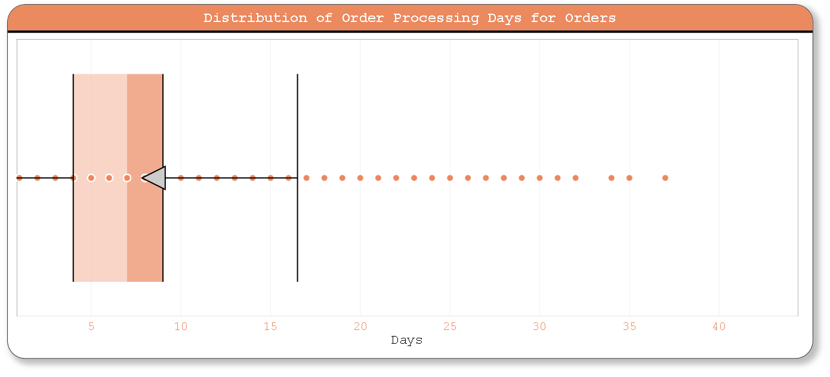
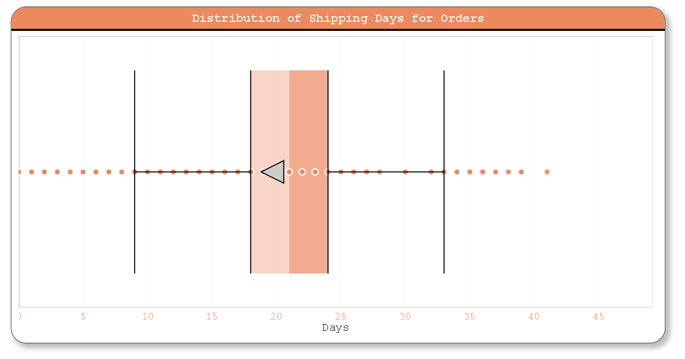
POWER BI PROBLEM STATEMENT
6. CAN WE VISUALIZE THE AVERAGE ORDER PROCESSING TIME OR SHIPPING DURATION USING A BAR CHART OR BOX PLOT?

Slide 29
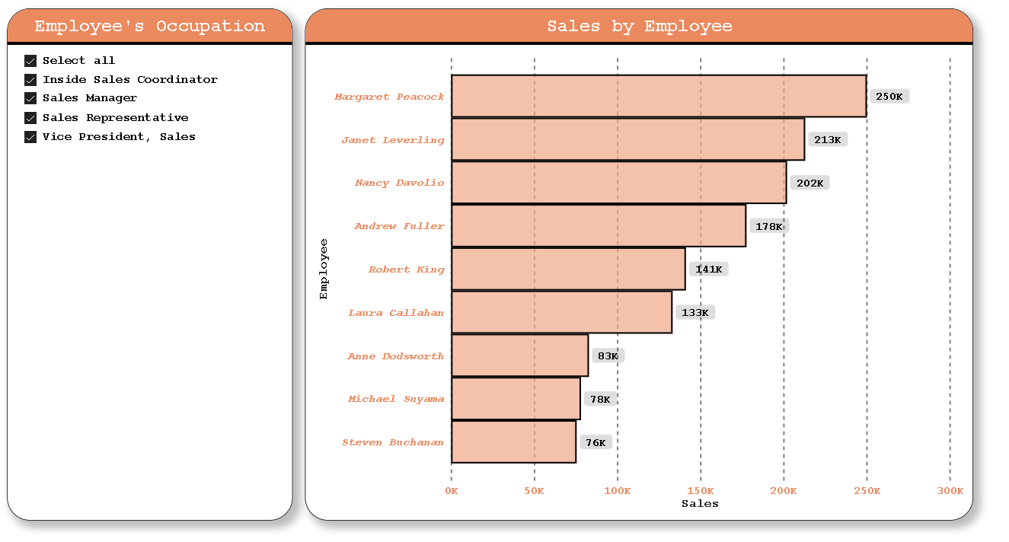
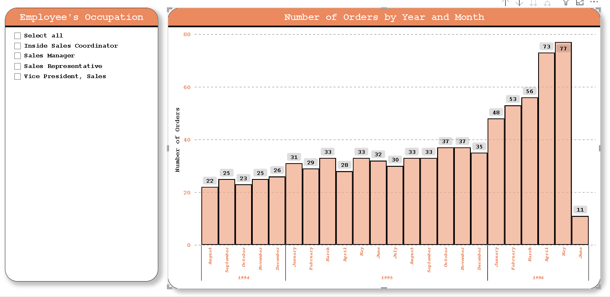
POWER BI PROBLEM STATEMENT
7. HOW DOES EMPLOYEE PRODUCTIVITY VARY ACROSS DIFFERENT DEPARTMENTS OR JOB ROLES? CAN WE CREATE A STACKED BAR CHART OR GROUPED COLUMN CHART TO VISUALIZE IT?

Slide 30
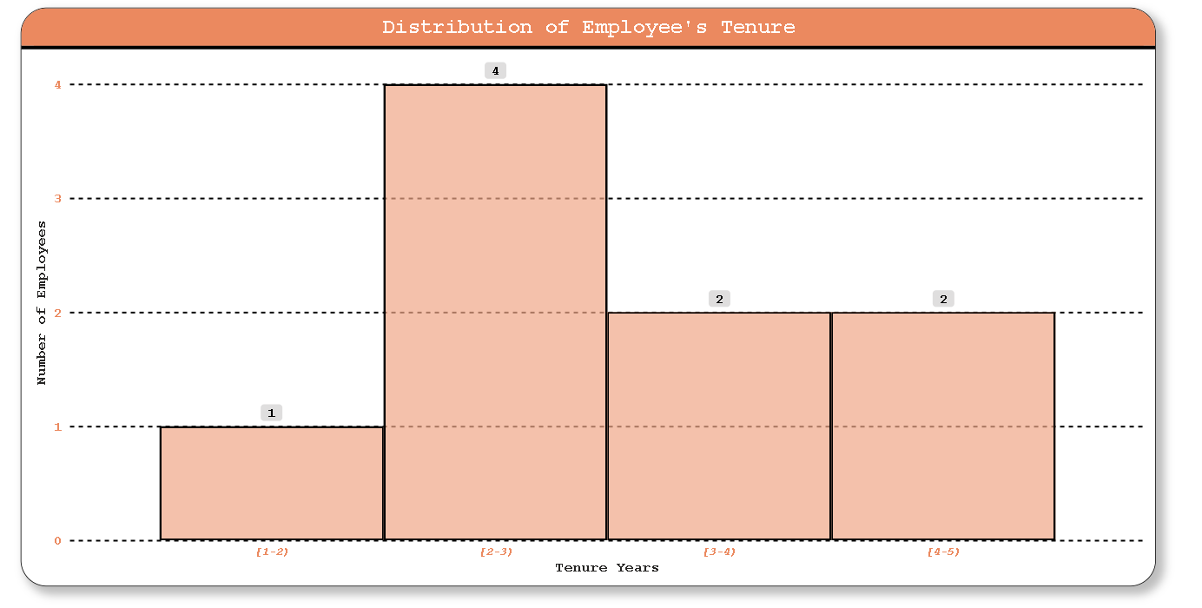
POWER BI PROBLEM STATEMENT
8. WHAT IS THE DISTRIBUTION OF EMPLOYEE TENURE? CAN WE CREATE A HISTOGRAM OR BOX PLOT TO DISPLAY IT?

Slide 31
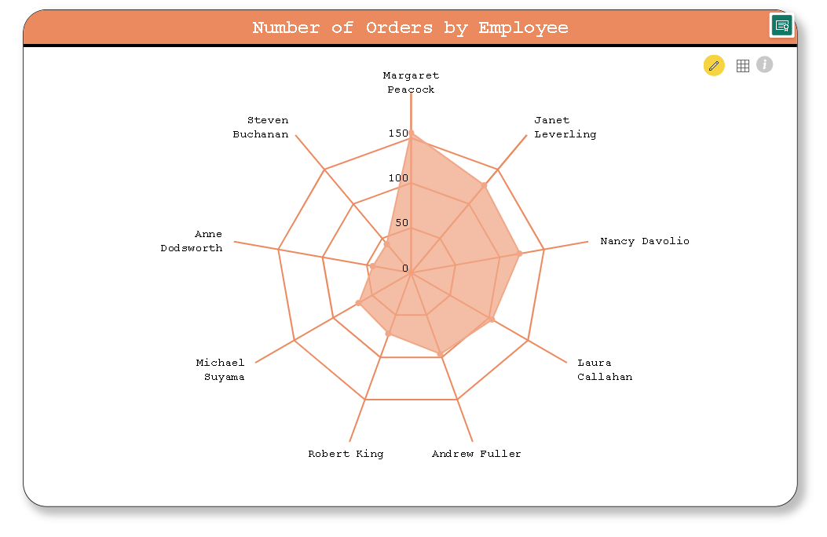
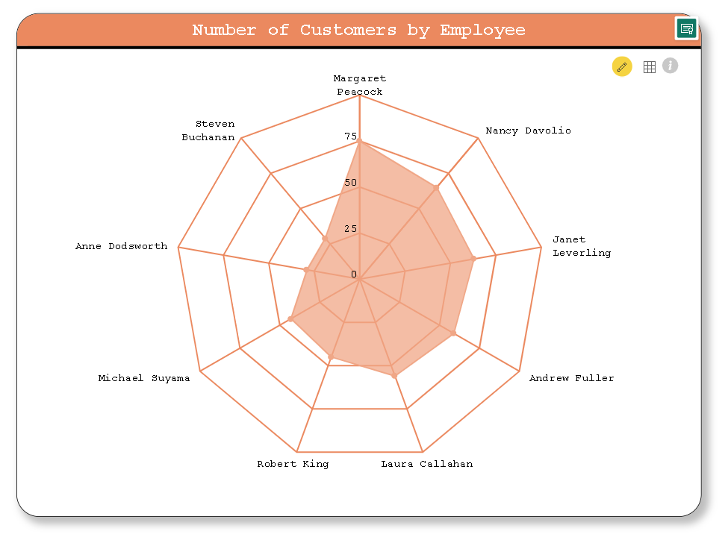
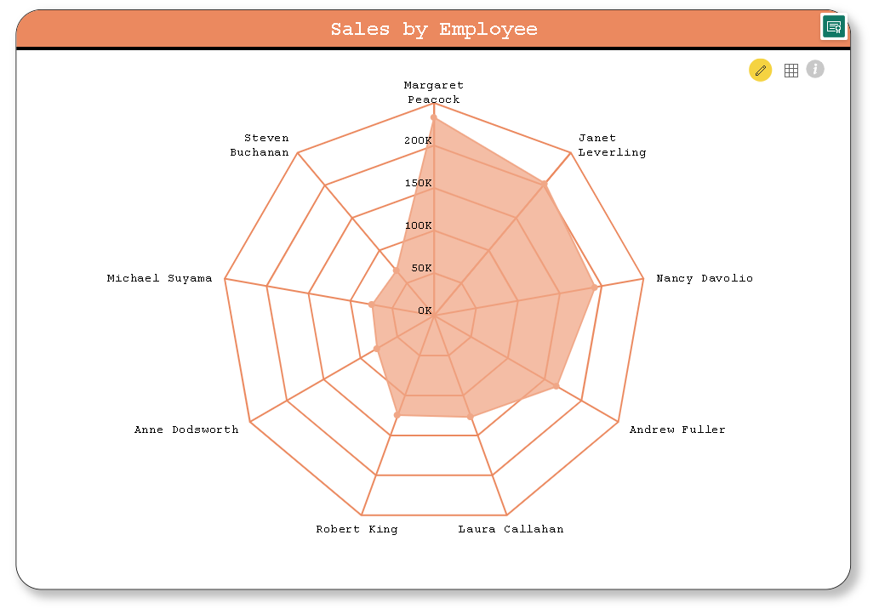
POWER BI PROBLEM STATEMENT
9. CAN WE VISUALIZE EMPLOYEE PERFORMANCE RATINGS OR KPIS USING A RADAR CHART OR BULLET GRAPH?

Slide 32
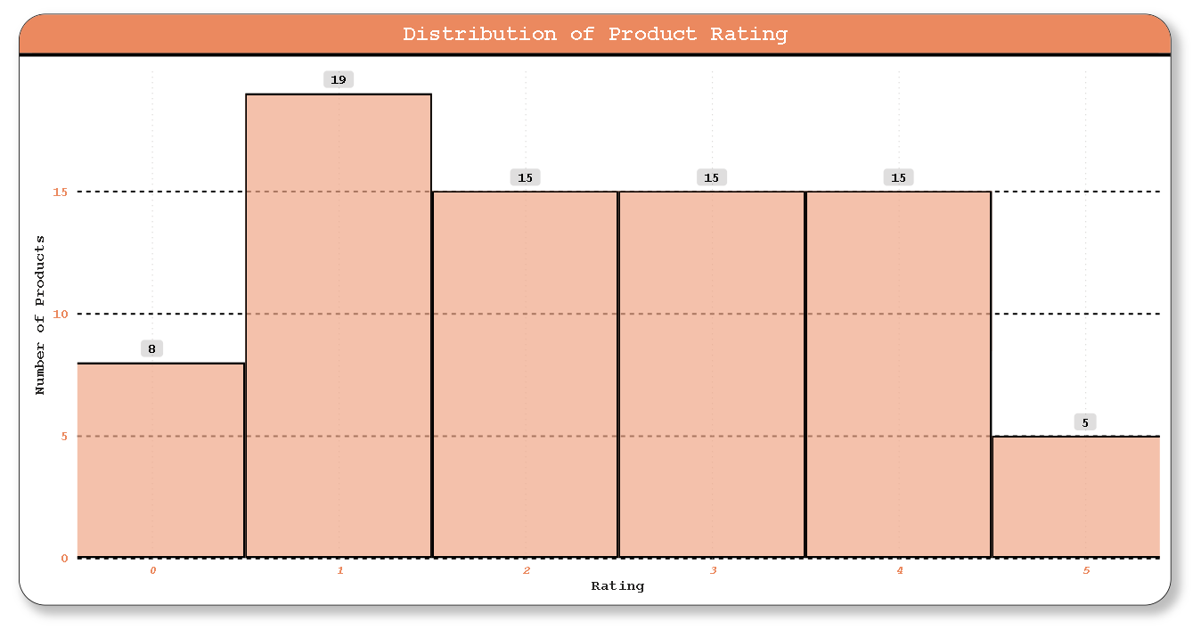
POWER BI PROBLEM STATEMENT
10. WHAT IS THE DISTRIBUTION OF PRODUCT RATINGS OR REVIEWS? CAN WE CREATE A HISTOGRAM OR STACKED BAR CHART TO VISUALIZE IT?

Slide 33
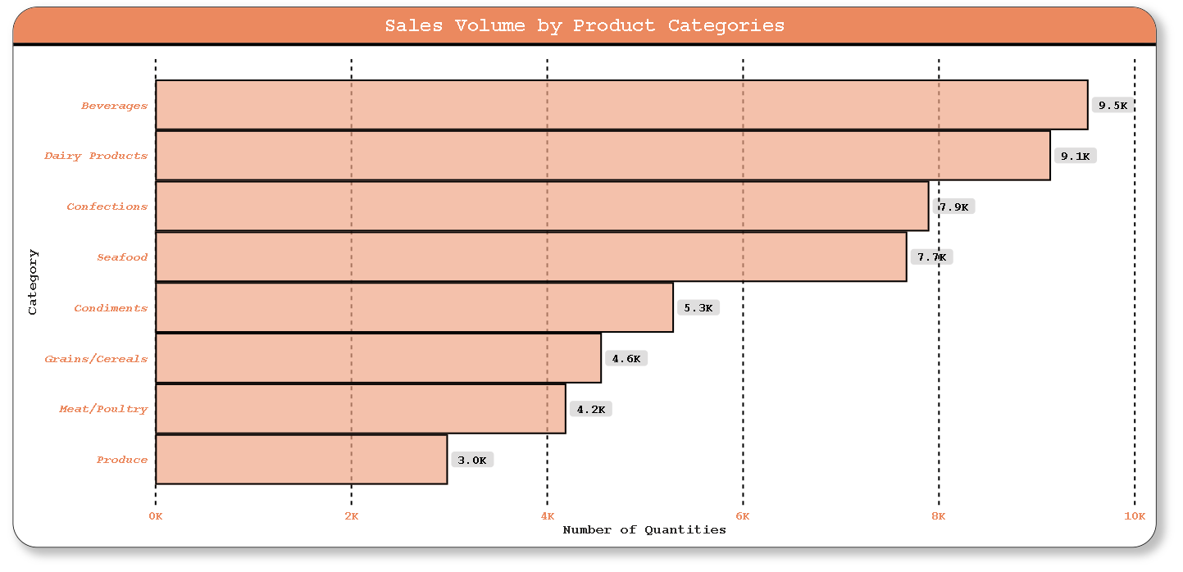
POWER BI PROBLEM STATEMENT
11. HOW DOES THE SALES VOLUME VARY ACROSS DIFFERENT PRODUCT CATEGORIES? CAN WE CREATE A BAR CHART OR TREE MAP TO DISPLAY IT?

Slide 34
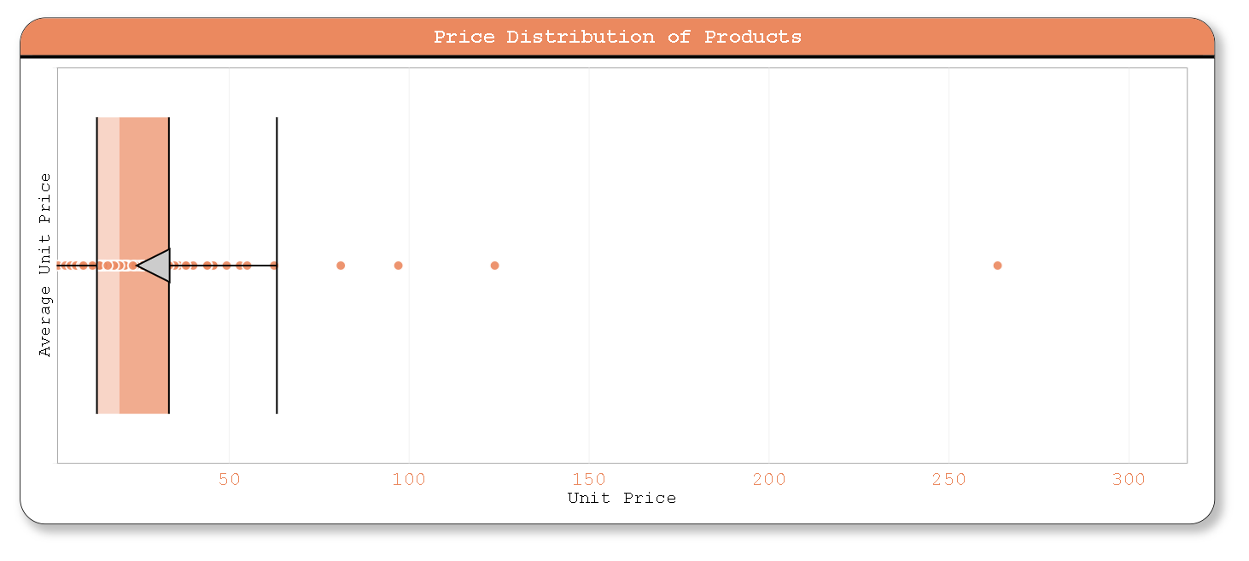
POWER BI PROBLEM STATEMENT
12. CAN WE VISUALIZE THE PRICING DISTRIBUTION OF PRODUCTS USING A BOX PLOT OR VIOLIN PLOT?

Slide 35
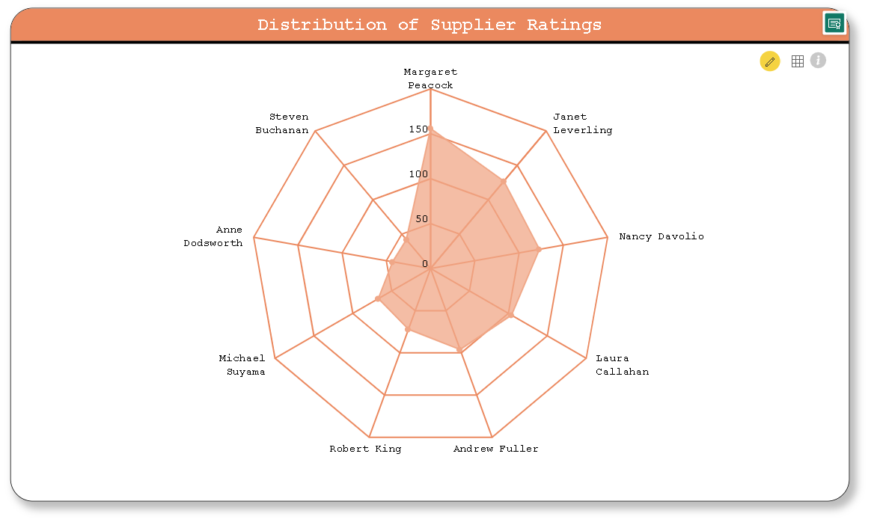
POWER BI PROBLEM STATEMENT
13. WHAT IS THE DISTRIBUTION OF SUPPLIER RATINGS OR PERFORMANCE METRICS? CAN WE CREATE A BAR CHART OR RADAR CHART TO VISUALIZE IT?

Slide 36
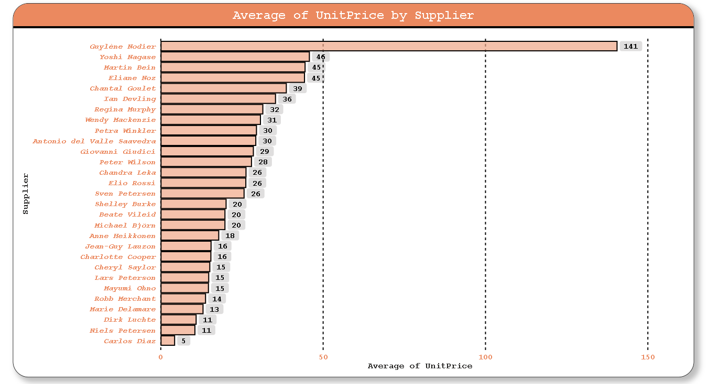
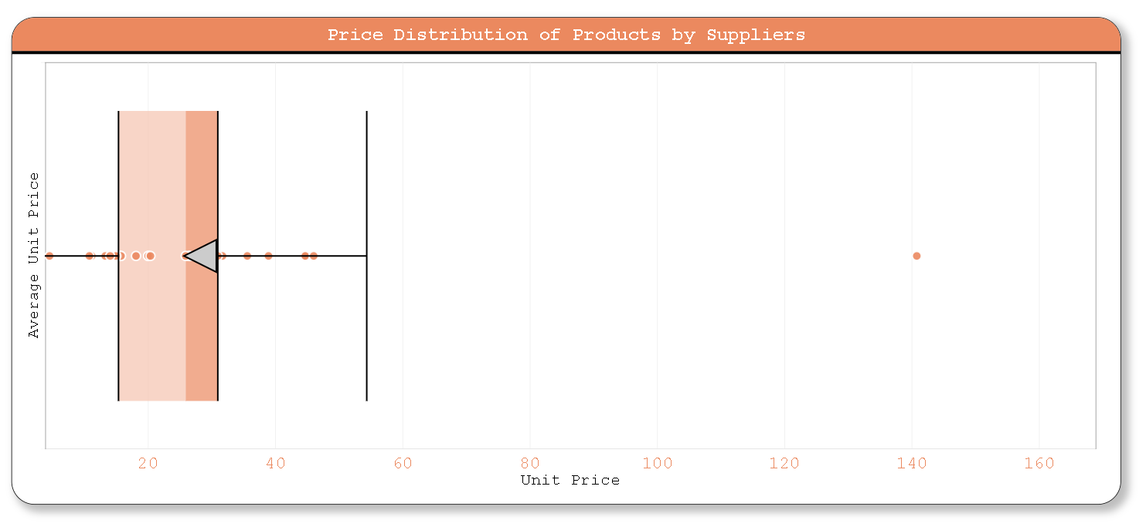
POWER BI PROBLEM STATEMENT
14. HOW DOES THE COST OR PRICING STRUCTURE VARY ACROSS DIFFERENT SUPPLIERS? CAN WE CREATE A BOX PLOT OR STACKED BAR CHART TO DISPLAY IT?

Slide 37

POWER BI PROBLEM STATEMENT
15. CAN WE VISUALIZE THE GEOGRAPHICAL DISTRIBUTION OF SUPPLIERS USING A MAP OR BUBBLE CHART?

Slide 38

POWER BI DASHBOARD

Slide 39


Slide 40


Slide 41


Slide 42


Slide 43


Slide 44


Slide 45


Slide 46

Conclusion
The comprehensive data analysis project using Power BI and Excel has provided valuable insights into Northwind Traders' operations. By analyzing sales, customer behavior, inventory, and employee performance, we've identified key areas for improvement and opportunities for growth.
Recommendations stemming from these insights include targeting high-value customer segments, optimizing inventory management, and boosting employee productivity. Implementing these recommendations will enable Northwind Traders to increase revenue, improve customer satisfaction, reduce costs, and enhance employee engagement.
Overall, this data analysis project equips Northwind Traders with the tools and knowledge needed to make informed, data-driven decisions, driving the company towards success in the wholesale market landscape.

Slide 47
thank you
mushab ali
mushab26.8@gmail.com

